Slide 1

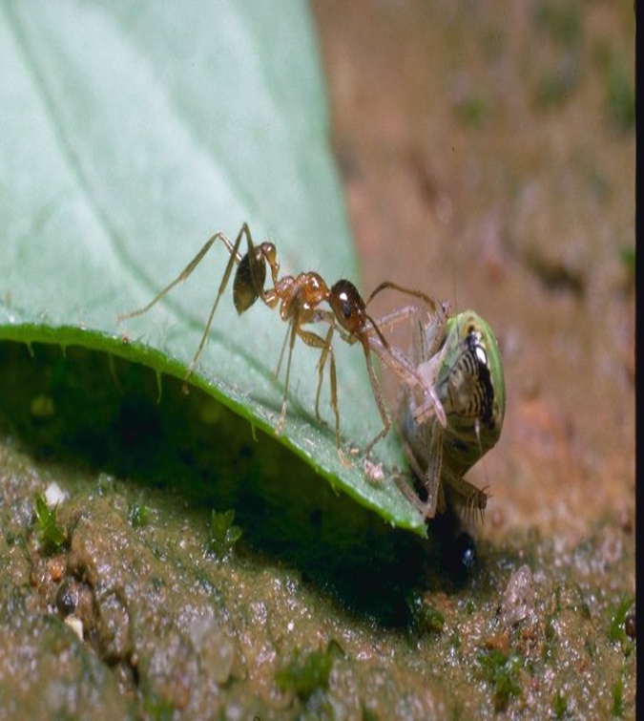
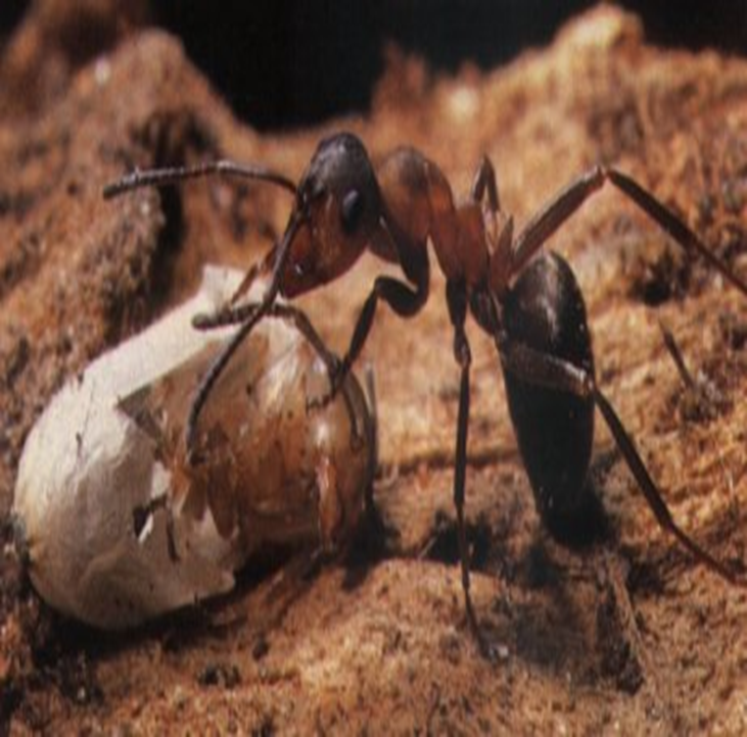
A* ALGORITHM

Slide 2
A* Algorithm
Input:
QUEUE: Path only containing root
Algorithm:
WHILE (QUEUE not empty && first path not reach goal) DO
Remove first path from QUEUE
Create paths to all children
Reject paths with loops
Add paths and sort QUEUE (by f = cost + heuristic)
IF QUEUE contains paths: P, Q
AND P ends in node N_{i} && Q contains node N_{i}
AND cost_P ≥ cost_Q
THEN remove P
IF goal reached THEN success ELSE failure

Slide 3
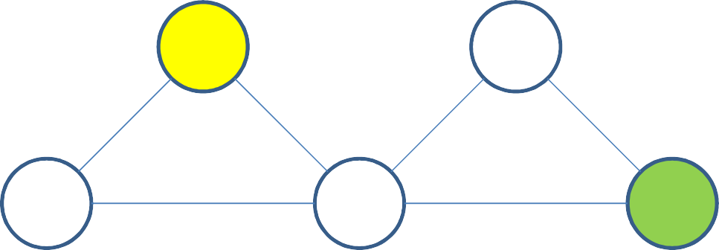
A* algorithm by Example
f = accumulated path cost + heuristic
0
7
S
7
QUEUE = path containing root
QUEUE: <S>
7
S
5
C
1
1
6
5
9
B
A
9
12
G
10
0

Slide 4
A* algorithm by Example
f = accumulated path cost + heuristic
S
Remove first path, Create paths to all children, Reject loops and Add paths. Sort QUEUE by f
1
10
A B
11 ¹
10
9
QUEUE: <SB,SA>
7
S
5
C
1
1
6
5
9
B
A
9
12
G
10
0

Slide 5
A* algorithm by Example
f = accumulated path cost + heuristic
S
Remove first path, Create paths to all children, Reject loops and Add paths. Sort QUEUE by f
1
10
A B
11
QUEUE: <SA,SBC,SBG,SBA>
10
10
A C G
₁₂ 13
20 ⁷
13
5
0
7
S
5
C
1
1
6
5
9
B
A
9
12
G
10
0

Slide 6
A* algorithm by Example
f = accumulated path cost + heuristic
S
IF P terminating in I with cost_P && Q containing I with cost_Q AND cost_P ≥ cost_Q THEN remove P
1
10
A B
11
QUEUE: <SA,SBC,SBG,SBA>
10
10
A C G
₁₂ 13
20 ⁷
13
5
0
7
S
5
C
1
1
6
5
9
B
A
9
12
G
10
0

Slide 7
A* algorithm by Example
f = accumulated path cost + heuristic
S
Remove first path, Create paths to all children, Reject loops and Add paths. Sort QUEUE by f
A B
QUEUE: <SBC,SBG,SAB>
10
9
B C G
₁₂ 13
19 ⁷
13
5
0
7
S
5
C
1
1
6
5
9
B
A
9
12
G
10
0

Slide 8
A* algorithm by Example
f = accumulated path cost + heuristic
S
IF P terminating in I with cost_P && Q containing I with cost_Q AND cost_P ≥ cost_Q THEN remove P
A B
QUEUE: <SBC,SBG,SAB>
10
9
B C G
₁₂ 13
19 ⁷
13
5
0
7
S
5
C
1
1
6
5
9
B
A
9
12
G
10
0

Slide 9
A* algorithm by Example
f = accumulated path cost + heuristic
S
Remove first path, Create paths to all children, Reject loops and Add paths. Sort QUEUE by f
B
QUEUE: <SBCG,SBG>
C G
13
0
13
7
S
5
C
1
1
6
5
12
0
G
9
B
12
A
9
12
G
10
0

Slide 10
A* algorithm by Example
f = accumulated path cost + heuristic
S
IF P terminating in I with cost_P && Q containing I with cost_Q AND cost_P ≥ cost_Q THEN remove P
B
QUEUE: <SBCG,SBG>
C G
13
0
13
7
S
5
C
1
1
6
5
12
0
G
9
B
12
A
9
12
G
10
0

Slide 11
A* algorithm by Example
f = accumulated path cost + heuristic
S
SUCCESS
B
QUEUE: <SBCG>
C
7
S
5
C
1
1
6
5
12
0
G
9
B
12
A
9
12
G
10
0

Slide 12
A * PROBLEM

Slide 13
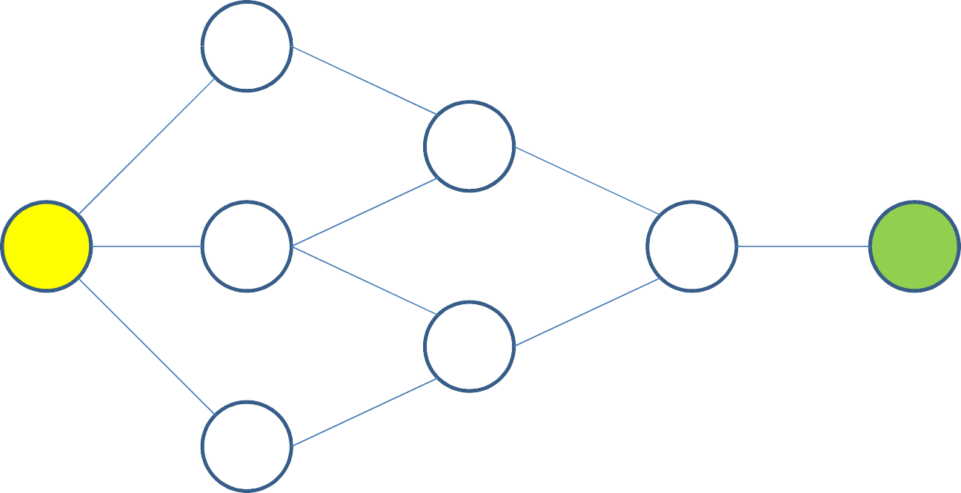
Problem
Perform the A* Algorithm on the following figure. Explicitly write down the queue at each
step.
10
A
6
4
6
E
4
17
13 6
1
0
S
5
B
F
3
G
7
2
D
6
10
4
C
6

Slide 14
A* SEARCH

Slide 15
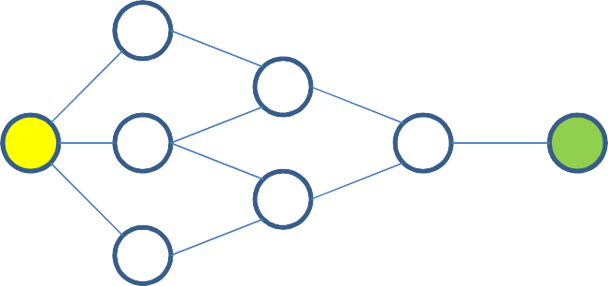
A* Search
10
0
17
S
A
6
17
6
4
13 6 E
5 _{B}
4
17
S
1
F
3
0
G
2
7 _{D}
10 4
6
C
6
QUEUE: S

Slide 16
A* Search
10
S
A
6
6
4
13 6 E
5 _{B}
4
17
S
1
F
3
0
G
2
7 _{D}
10 4
6
6
10
A B C
C
6
5
10
16 ₁₃
18 ₄
14
QUEUE: SC
SA SB

Slide 17
A* Search
10
S
A
6
6
4
13 6 E
5 _{B}
4
17
S
1
F
3
0
G
2
7 _{D}
10 4
6
6
10
A B C
C
6
5
16 ₁₃
18
QUEUE: SA
SCD SB
16
2
D
18

Slide 18
A* Search
10
S
A
6
6
4
13 6 E
5 _{B}
4
17
S
1
F
3
0
G
2
7 _{D}
10 4
6
A B C
C
6
5
13
18
QUEUE: SAE SCD
SB
12
4
E
16
2
D
16
18

Slide 19
A* Search
10
S
A
6
6
4
13 6 E
5 _{B}
4
17
S
1
F
3
0
G
2
7 _{D}
10 4
6
A B C
C
6
5
13
18
QUEUE: SAEF SCD
SB
SAEB
E
16
2
D
18
18
13
B F
₃₁ 16
17
1

Slide 20
A* Search
10
S
A
6
6
4
13 6 E
5 _{B}
4
17
S
1
F
3
0
G
2
7 _{D}
10 4
6
A B C
C
6
5
13
18
QUEUE: SCD
SB SAEFG SAEFD
E
16
2
D
18
F
22
2
D G
₂₄ 19
19
0

Slide 21
A* Search
10
S
A
6
6
4
13 6 E
5 _{B}
4
17
S
1
F
3
0
G
2
7 _{D}
10 4
6
A B C
C
6
5
13
18
QUEUE: SB SAEFG SCDF SCDB
E
D
F
23
13
B F
₃₆ 22
23
1
19
0
G
19

Slide 22
A* Search
10
S
A
6
6
4
13 6 E
5 _{B}
4
17
S
1
F
3
0
G
2
7 _{D}
10 4
6
A
B
C
6
QUEUE: SBD SBE SAEFG
E
12
2
D E
₁₄ 11
15
4
F
19
0
G
19

Slide 23
A* Search
10
S
A
6
6
4
13 6 E
5 _{B}
4
17
S
1
F
3
0
G
2
7 _{D}
10 4
6
A
B
C
6
QUEUE: SBE SBDF SAEFG SBDC
E
D E
11
4
15
F
18
4
C F
₂₂ 18
19
1
19
0
G
19

Slide 24
A* Search
10
S
A
6
6
4
13 6 E
5 _{B}
4
17
S
1
F
3
0
G
2
7 _{D}
10 4
6
A
B
C
6
QUEUE: SBEF SAEFG SBDF SBDC SBEA
E
D
E
F
18
4
C
₂₂ 18
F
₁₉ 17
A F
₂₇ 15
16
1
10
1
19
0
G
19

Slide 25
A* Search
10
S
A
6
6
4
13 6 E
5 _{B}
4
17
S
1
F
3
0
G
2
7 _{D}
10 4
6
A
B
C
6
QUEUE: SBEFG SAEFG SBDC SBEFD SBEA
E
D
E
F
18
4
C
17
10
A F
22
27
19
0
G
21
2
D G
₂₃ 18
19
18
0

